Slide 1
Many Dimensions of Patient-Centered Care and Quality Outcomes
Lawrence Friedman, M.D.
Professor of Pediatrics and Medicine
University of California, San Diego

Slide 2
Conflicts of Interest
I have no Conflicts of Interest Nor Receive Professional Income from Any Entity other than The University of California
Slide 2 of 47

Slide 3
Patient–Centered and Quality….
“…… both difficult to define….but I know it when I see it….”
Paraphrasing Potter Stewart,
Associate Justice, US Supreme Court 1964
Slide 3 of 51
Slide 3 of 47

Slide 4
Why Have These Become Issues and Caused an Emerging Paradigm Shift
Slide 4 of 47

Slide 5
National Health Expenditures as
a Percentage of GDP, 1960-2017
2019
19.3%
2009
17.3%
2009
$2.5 trillion
SOURCE: Centers for Medicare & Medicaid Services, Office of the Actuary, National Health Statistics Group. 9/2010
Slide 5 of 47
Notes:
Tuesday, February 24, 2009 Contact: CMS Office of Public Affairs
202-690-6145
GROWTH IN NATIONAL HEALTH EXPENDITURES EXPECTED TO SLOW BY 2009 AS A RESULT OF RECESSION
BUT HEALTH TO CONTINUE GROWING AS SHARE OF ECONOMY
Growth in national health expenditures (NHE) in the United States is expected to significantly outpace economic growth in 2008 and 2009 due to the recession, according to a report issued today by the Centers for Medicare & Medicaid Services (CMS). The report was prepared by CMS’s Office of the Actuary and published online by the journal Health Affairs.
In 2008, growth in national health expenditures is expected to be 6.1 percent, as health spending increases from $2.2 trillion in 2007 to $2.4 trillion in 2008, while growth in the economy, as measured by the gross domestic product (GDP) is anticipated to be 3.5 percent. For 2009, health spending is projected to increase 5.5 percent while GDP is expected to decrease 0.2 percent. The health share of GDP is expected to increase from 16.2 percent in 2007 to 16.6 percent in 2008 and to 17.6 percent in 2009. This represents about one-third of the total increase in the health share of GDP for 2008 through 2018.

Slide 6
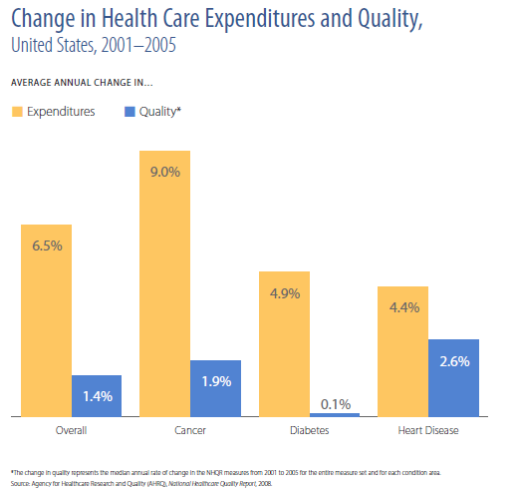
Slide 20 of 51
Slide 6 of 47

Slide 7
Health Care Examples Underuse
50% of elderly fail to receive pneumococcal vaccine
50% of heart attack victims fail to receive beta-blockers
Slide 15 of 51
Slide 7 of 47

Slide 8
Health Care Examples Overuse
30% of children receive excessive antibiotics for ear infections
20% to 50% of many surgical operations are unnecessary
50% of X-rays in back pain patients are unnecessary
Slide 14 of 51
Slide 8 of 47

Slide 9
What Does Medical Literature Say about Patient-Centered Care?
Four Key Attributes of Patient-Centered Care
  “Whole Person” Care
  Coordination and Communication
  Patient Support and Empowerment
    Transparency
    Individualization
    Recognition
    Respect
    Dignity
    Choice
  Access
Slide 9 of 47

Slide 10
This Is Actually Complicated
Defining Personal Characteristics, Conditions and Preferences
  Age, gender, education, connectivity (community and technology), culture, etc.
Defining Clinical and Wellness Options
  Understanding resources, decisions with less than perfect data
Defining Patient Involvement for Improvement
  Understanding what motivates each individual
  Home phlebotomy example
How can the Health System work for you
  Not all health systems are the same and providers have varied communication styles and capabilities
Slide 10 of 47

Slide 11
Key Patient-Centered Research Questions
  “Given Individual Characteristics, Conditions and Preferences…..”
    What should I expect will happen to me?
    What are my options, and what are the potential benefits and harms of those options?
      Shared Decision-making
    What do I do to improve the outcomes that are most important to me?
    How can clinicians and the care delivery systems they work in help make the best decisions about my health and health care?
    - Annals of Internal Med, Sept. 18, 2012, p. 446
Slide 11 of 47

Slide 12
How Do Patient-Centeredness and Quality Converge
Doing the Right Thing at the Right Time
Doing the Right Thing with the Right Information
Doing the Right Thing According to Patient Wishes
Doing the Right Thing “All the Time”
Doing the Right Thing Efficiently and Effectively
Slide 12 of 47

Slide 13
Reading My Recent Mail
New Yorker August, 2012
  Should Hospitals be More Like Restaurant Chains?
    Restaurant Chains have managed to combine quality control, cost control, and innovation. Lessons from the Cheesecake Factory.
    - Atul Gawande
Annals of Internal Medicine October 2, 2012
  Inviting Patients to Read Doctors Notes (Delbanco, et al)
    Patients (13,500) liked it and no doctors (105) wanted it to stop
  Screening for Cardiovascular Disease with EKGs
    US Preventive Task Force Recommends Against Routine Screening with Resting or Exercise EKGs for Patients in Patients with Low Risk for Coronary Heart Disease
Slide 13 of 47

Slide 14
Quality and Patient-Centered From Whose Perspective
Patients
Providers
Purchasers
Payers
Slide 4 of 51
Slide 14 of 47

Slide 15
Measuring and Thinking About Quality of Care
Structure of Care for Quality - proper facilities and personnel
Process Quality – doing the right things at the right time
Outcome Quality – getting the right results
Slide 23 of 51
Slide 15 of 47

Slide 16
Patient Perspective
Access
  In Person and Phone, Internet, Web-Portals, etc.
Staff and Doctors Interpersonal Interactions
Cleanliness
Amenities
  Parking, Signage, Physical Site
Knowledge
  Patients Expect This
Cultural Appropriateness
Being Heard and Being Engaged
Slide 5 of 51
Slide 16 of 47

Slide 17
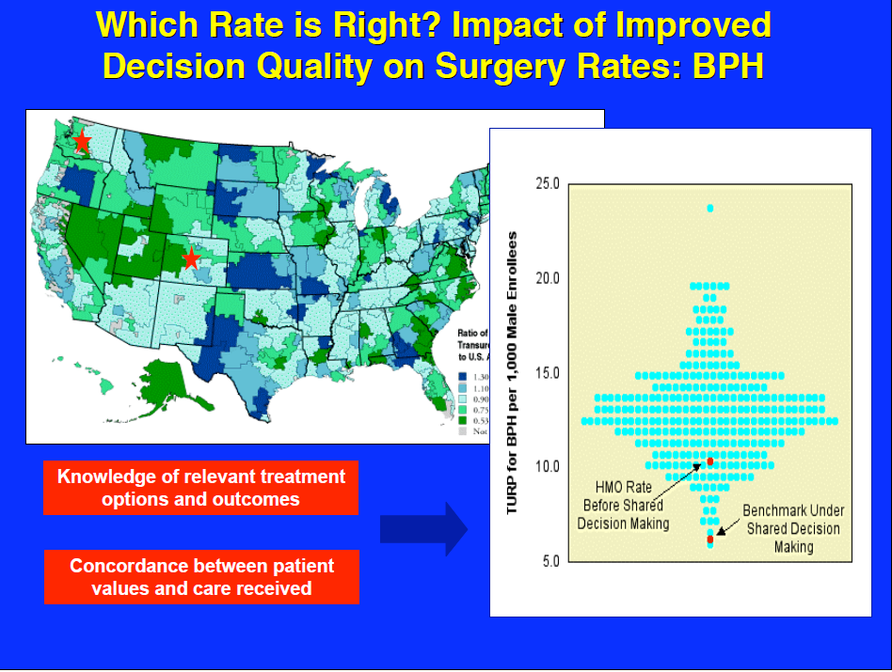
Slide 17 of 47

Slide 18
Provider Perspective
System Quality
  Information Access
  Appropriate Staffing
  Scheduling Access
    Access to ORs
  Standards Adherence
  Decision-Making Representation
Patient Quality
  Outcome related
    Most think they are doing the right thing
  Meeting Standards
    Peer Comparisons
Slide 6 of 51
Slide 18 of 47

Slide 19
The Complexity of Modern
Medicine Exceeds the Inherent Limitations of an Unaided Human Mind
- David Eddy, M.D.
Slide 37 of 51
Slide 19 of 47

Slide 20
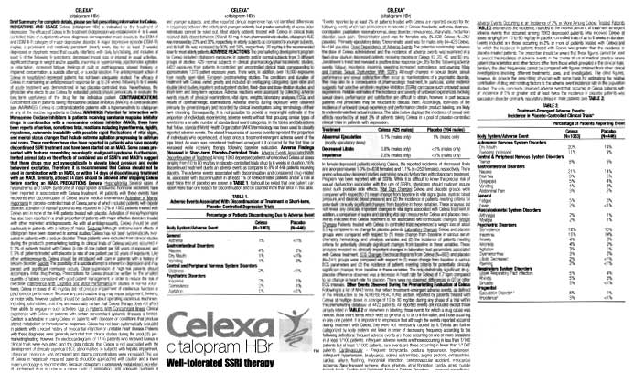
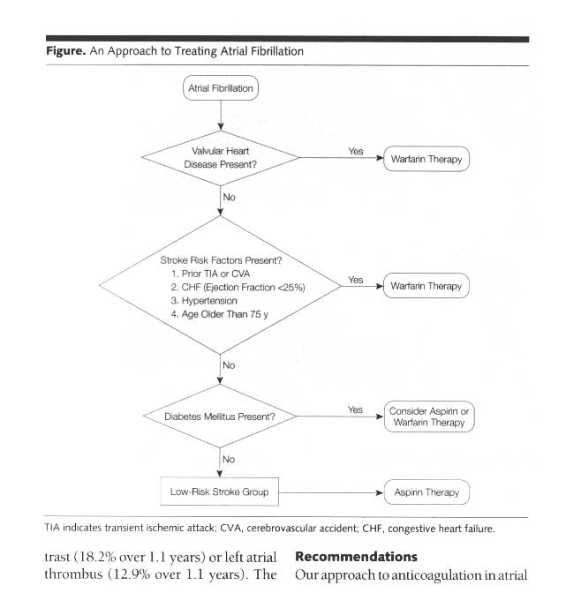
A Sea of Changing Information
10,000 drugs…125,000 diseases…
15,000 clinical guidelines…
Drug X
Use after
heart attack decreases mortality
by 40%
Do not use in
breastfeeding
mother
Avoid in patients
with coronary artery
disease
Slide 38 of 51
Slide 20 of 47
Notes:
`

Slide 21
Purchaser/Payer Perspective
Patient
  Satisfaction
Provider
  Meet or Exceed Clinical Guideline Standards
  Limited Practice Variation
  Efficiency and Value Oriented
System
  Cost-Effective
  Systems to Limit Practice Variation
  System to Monitor Safety and Clinical Quality
Slide 7 of 51
Slide 21 of 47

Slide 22
What Does This All Mean For Physicians
Almost Everything Gets Measured
Less Autonomy
More Accountability
More Public Reporting
More Benchmarking Against Peers
More Need for Evidence-Based Decision Making
Slide 24 of 51
Slide 22 of 47

Slide 23
Practical Ways to Improve Patient-Centered Care and Quality
Agree on Metrics
Measure It
Provide Feedback
Create Teams
Create Interventions
Measure Again
Slide 23 of 47

Slide 24
“The First Law of Improvement”
Every system is perfectly designed to achieve the results it gets.
Slide 39 of 51
Slide 24 of 47

Slide 25
A Fundamental Improvement Rule
If You Can’t Measure It, You Can’t Improve It
Slide 22 of 51
Slide 25 of 47

Slide 26
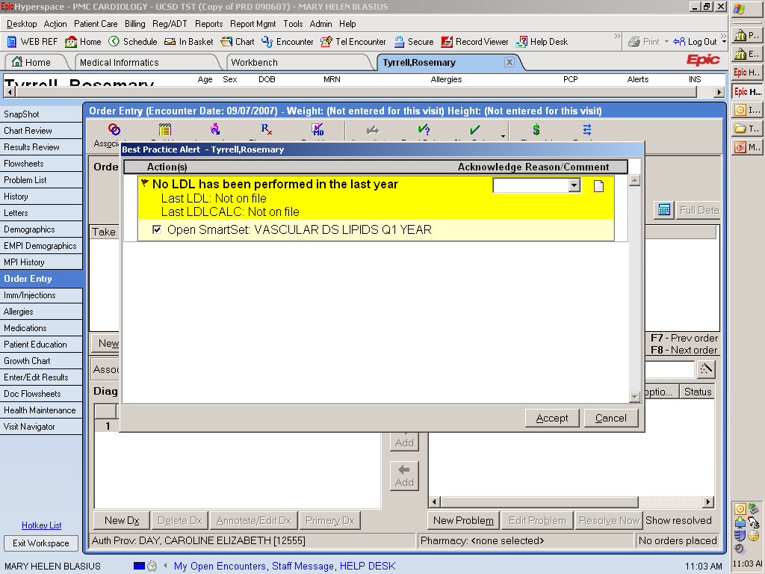
BPA for LDL measured q1year
Slide 26 of 47

Slide 27
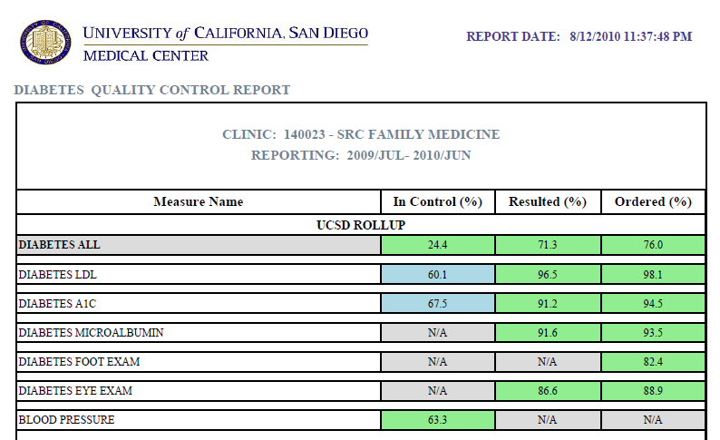
Current Quality Indicators
Slide 27 of 47

Slide 28

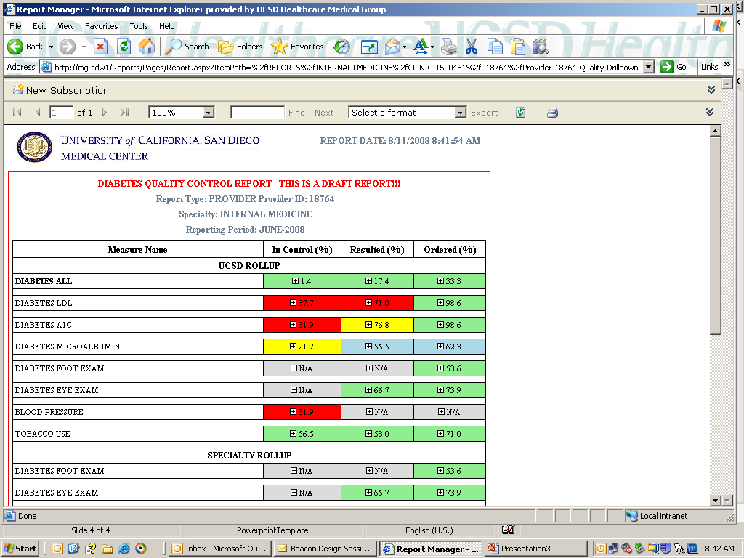
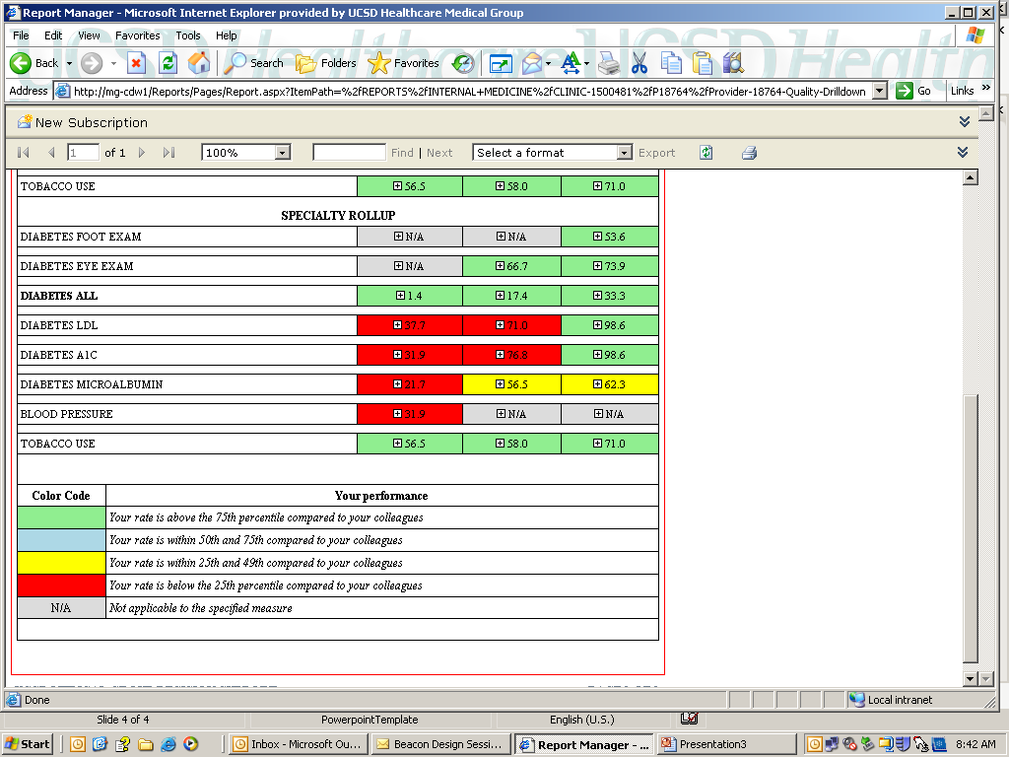
Provider Reports
Global
measurement
Area of relative
poor
performance
Multiple measures displayed
simultaneously
Slide 26 of 51
Slide 28 of 47

Slide 29
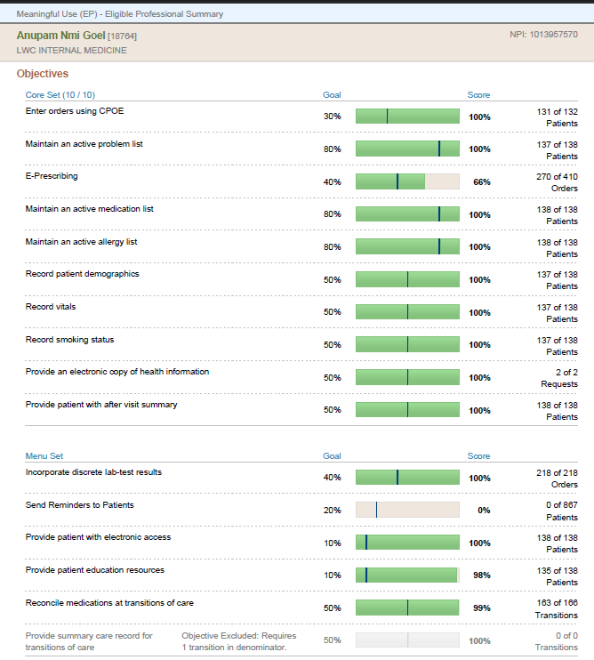
Sample Provider Report
Slide 31 of 51
Slide 29 of 47

Slide 30
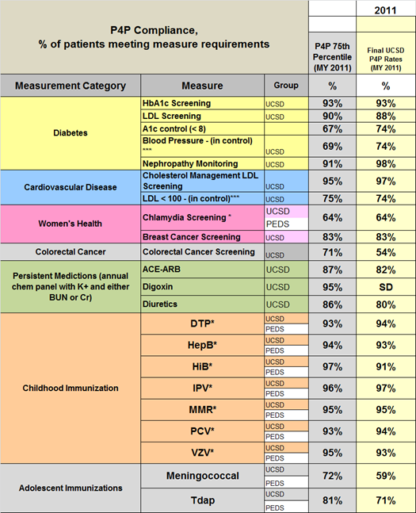
Managed Care P4P Measurement Year 2011 Final Rates
Slide 30 of 47

Slide 31
Improvement Interventions
Report Dissemination
  Chairs, Board, Clinic Managers, Faculty
Incentive Alignment
  Patient Satisfaction for staff, faculty, and Leaders
Staff Engagement to Contact Patients
  Post Discharge, Post-ED, and Health Maintenance
  Home Phlebotomy
EMR Decision Support Tools
  Best Practice Alerts and “Smart” Order Sets
Patient Web-Portal
  Will Allow Pushed Reminders to Patients
Slide 31 of 47

Slide 32
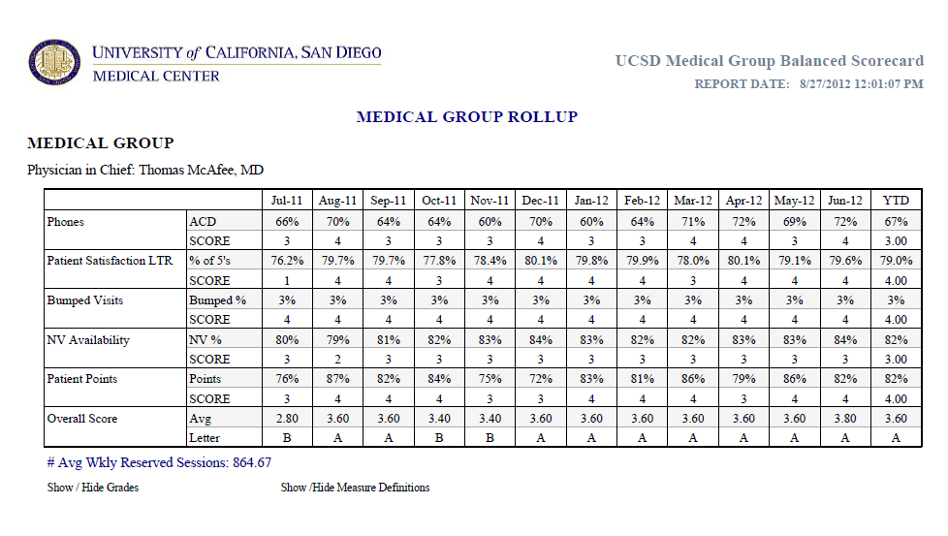
Slide 32 of 47

Slide 33
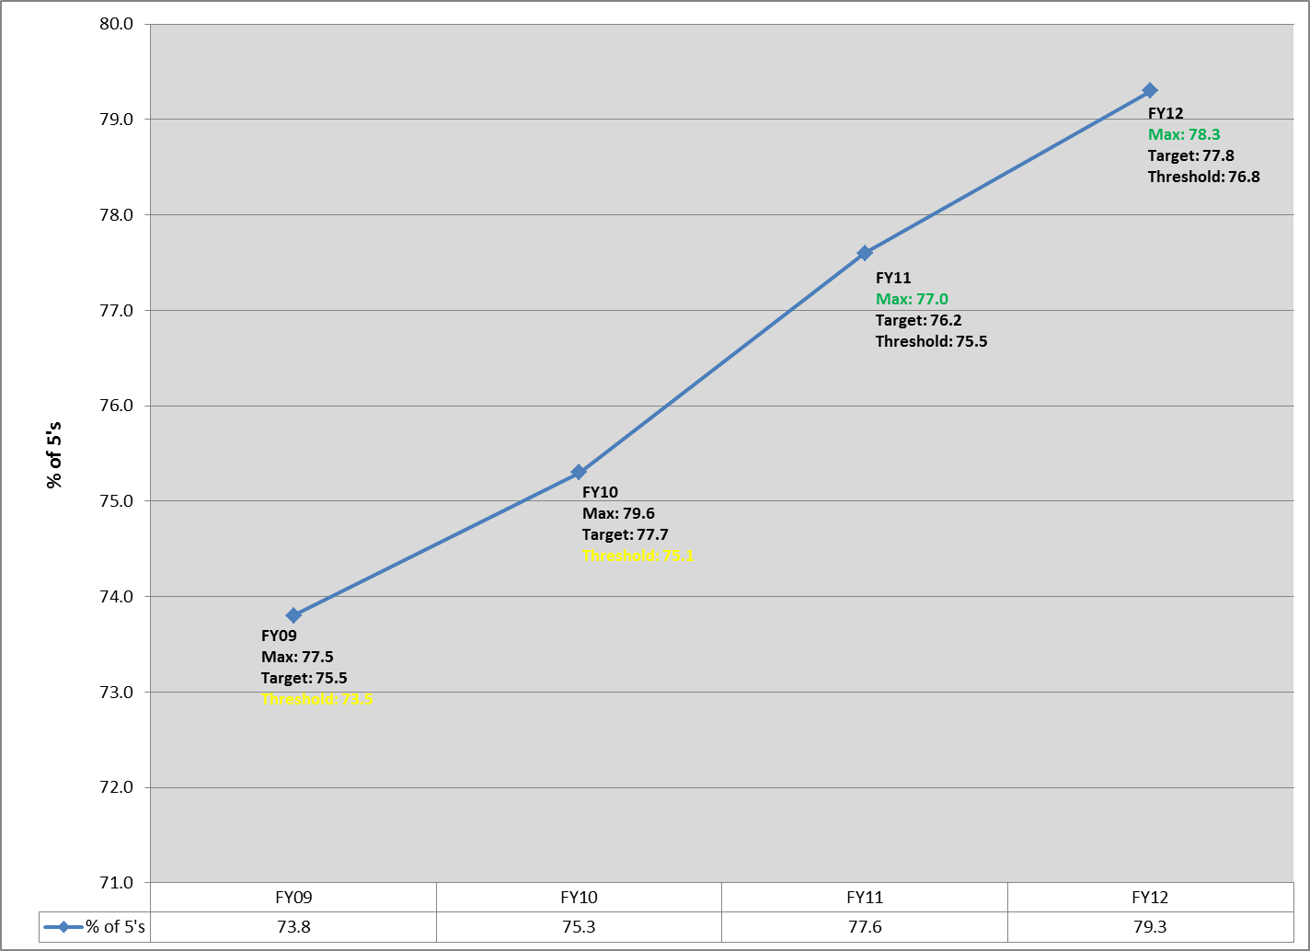
Patient Satisfaction: Annual Trends
FY09- FY12
Slide 33 of 47

Slide 34
ICU Catheter-related
Blood Stream Infections
Education
Line Cart
30
Checklist
20
Rate/1,000 Catheter days
10
NNIS Mean
0
Jan
Feb
Mar
Apr
May
Jun
Jul
Aug
Sep
Oct
Nov
Dec
Jan
Feb
Mar
April
May
June
July
August
Slide 34 of 47

Slide 35
Using Other New Technology
Web Portals and Access to Medical Records
Telemedicine
Remote Monitoring
Gene Mapping
Cell Phone Messaging for Reminders
  Remind of Vaccine Series Completion
    Being Done by Merck for Gardasil
  Remind of Appointments
  Reminders for Compliance*
  Reminders for Smoking Cessation**
  Granger, B, et al, Cur Opin Cardio 26:279-287, 2011 *
  Free C, et al, Lancet, 2011; 378:49-55. **
Slide 35 of 47

Slide 36
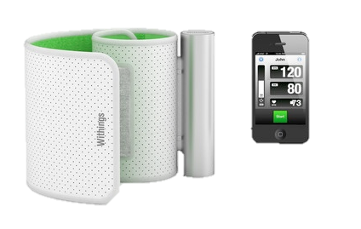
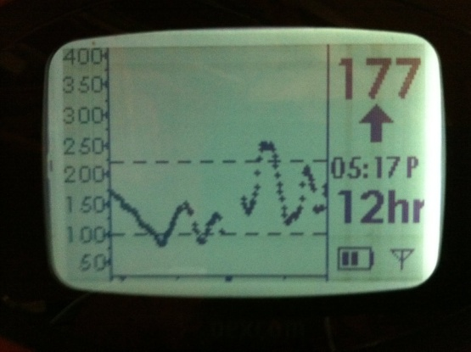

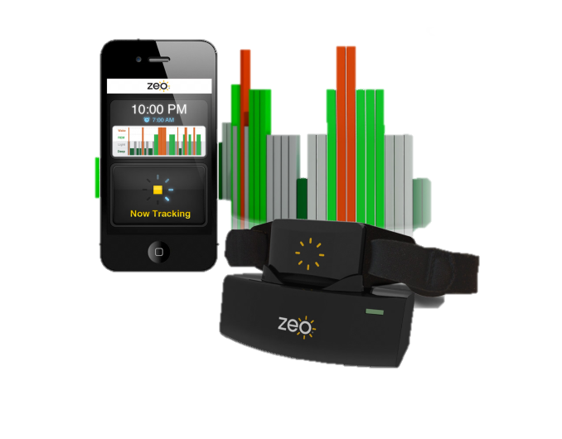
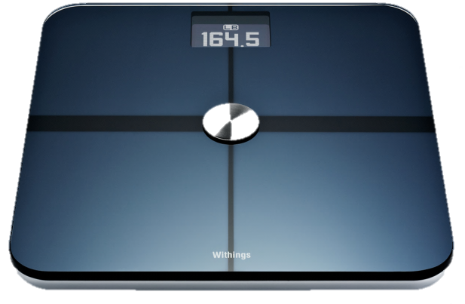
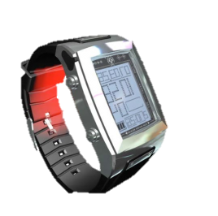
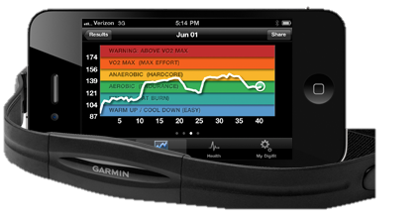
BLOOD PRESSURE
ACTIVITY
CONTINUOUS GLUCOSE MONITORING
SLEEP OPTIMIZATION
WEIGHT & BODY COMPOSITION
EXERCISE AND HEART RATE
Slide 36 of 47
Notes:
The various devices that we leverage in our practice.

Slide 37
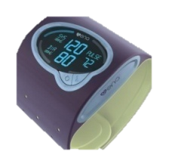
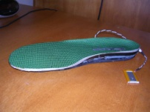




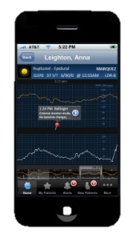

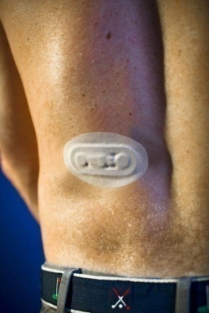



Mobile Health Technology
Gateway
Peripheral Sensors
4G Wireless
Data Network
Body Area
Network
Smart Band-Aids
Slide 37 of 47
Notes:
Today, Wearable computer devices serve as ingenious sensors for temperuture, calories burned, steps per day, blood glucose, activity, heart rate,
Which can then via the over 50 million smart phones in use send real time information to the patient health care or in this case the weight loss team.
Body area network (BAN), wireless body area network (WBAN) or body sensor network (BSN) are terms used to describe the application of wearable computing devices.^{[1][2][3]} This will enable wireless communication between several miniaturized body sensor units (BSU) and a single body central unit (BCU) worn at the human body.

Slide 38
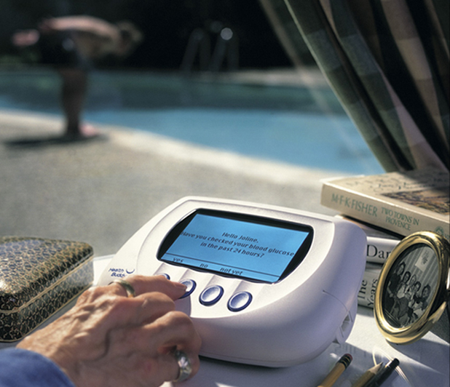
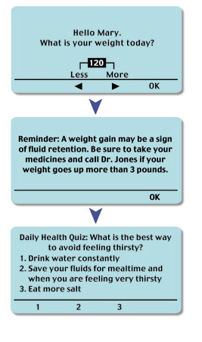
Home Telehealth
Slide 38 of 47
Notes:
Example of Hometelehealth

Slide 39
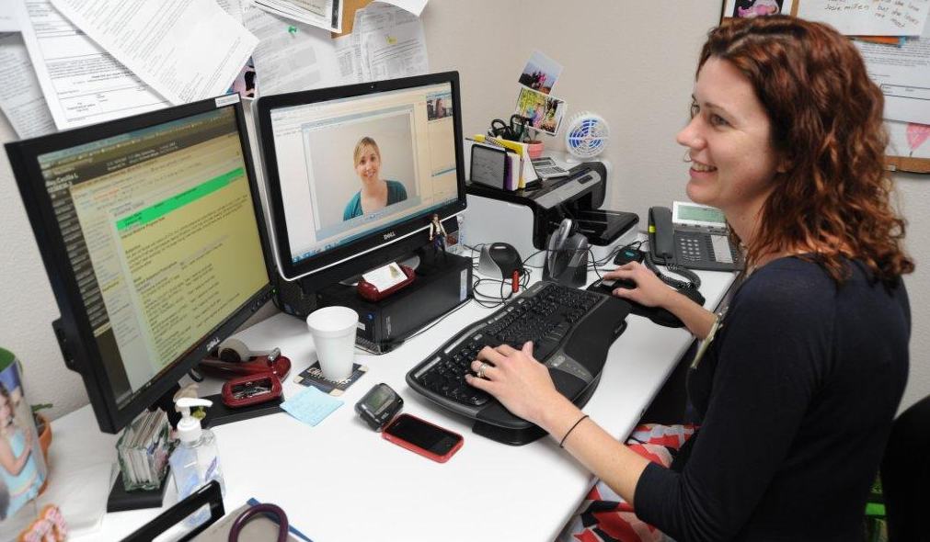
Home Telemedicine: Convergence with EHR and Mobile Monitoring
Slide 39 of 47

Slide 40
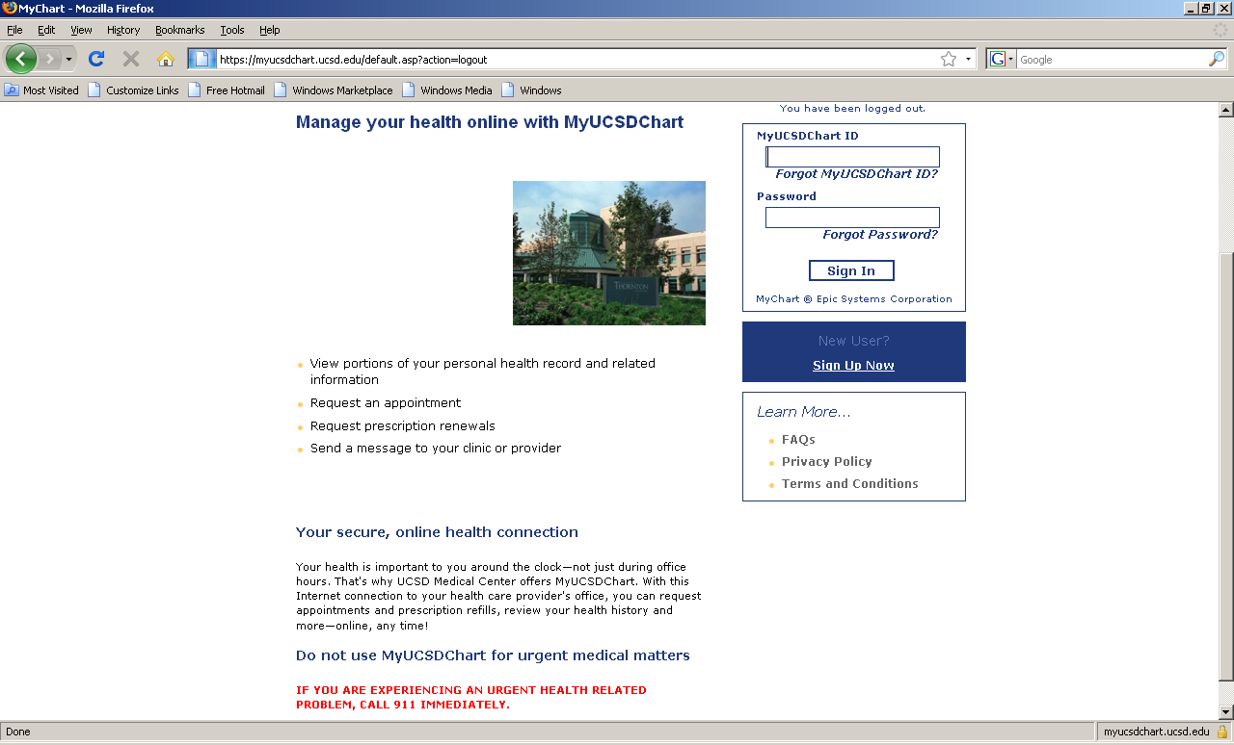
Slide 40 of 47

Slide 41
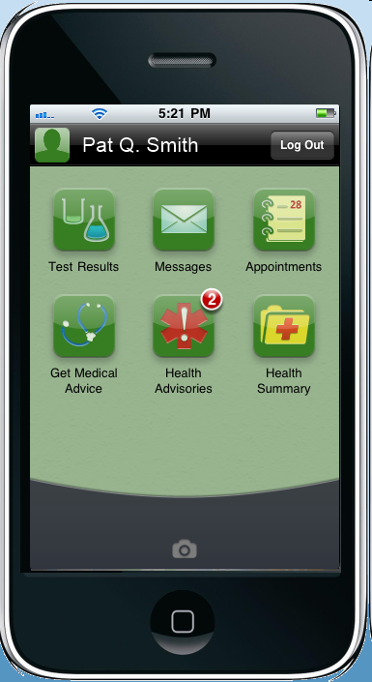
Once logged in, patients can:
View test results
Read messages from physician & clinic
View upcoming appointment details & cancel appointments
View past appointments & After Visit Summaries
Send non-urgent messages to physician & clinic
View preventive health reminders
View current and historical information in the health record
Slide 41 of 47

Slide 42
Scientifically leveraging personalized genomics, mobile health technologies and personalized medicine to radically improve lives and lower healthcare costs.
Corporate Overview 2012
Samir Damani, M.D., Pharm.D., F.A.C.C.
Slide 42 of 47

Slide 43
Engaging Multiple Health Metrics Leads to more Dramatic Results
Journal of the American Medical Association 2012 study followed 45,000 adults for 15 years
Study demonstrated a 3 fold reduction in death (10% vs. 30%) with individuals that maintained five ideal health metrics versus those individuals that only had one ideal health metric
Ideal Health Metrics include:
  No smoking
  Body Mass Index below 25
  Hemoglobin A1C below 5.7%
  Blood Pressure below 120/80
  Serum cholesterol below 200
  Moderate Alcohol Consumption
  Adequate physical activity
Less than 2% of Americans have 6 ideal health metrics
Leveraging mobile health technology, genomics, personalized medicine, fitness, and nutrition enables a much greater percentage of individuals achieving ideal health behaviors
Slide 43 of 47
Notes:
The critical point of this slide is to show the graphic where increasing numbers of ideal health behaviors result in a

Slide 44
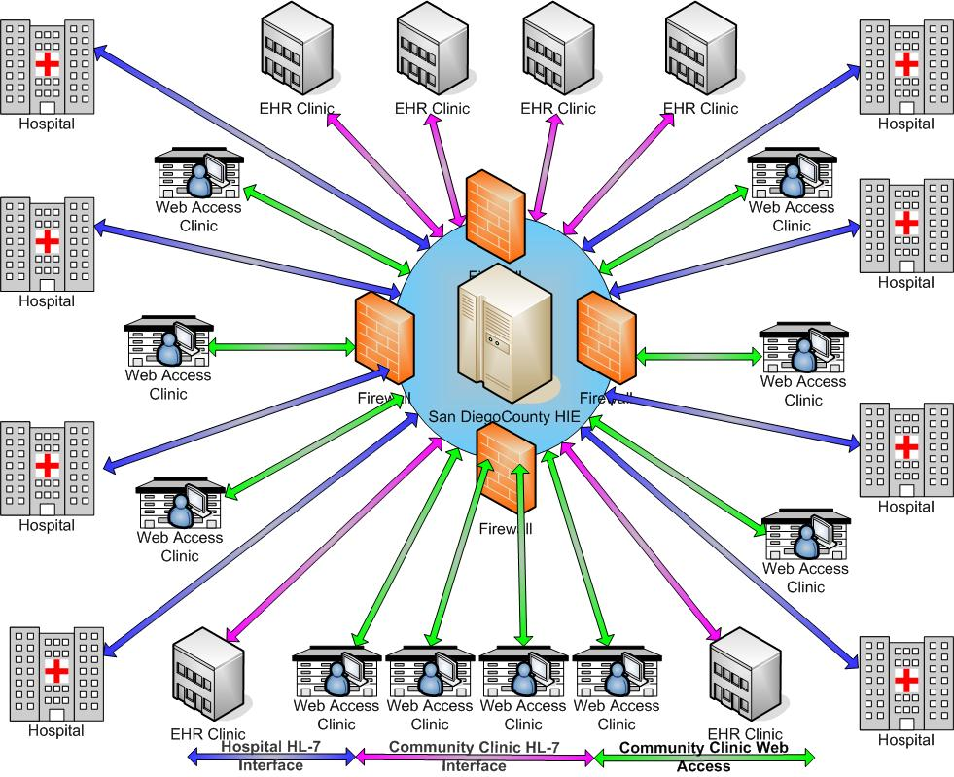
Health Information Exchange
The Next Challenge……
Slide 44 of 47

Slide 45
Five Core Educational Competencies for 21st Century Quality Health Care (IOM)
Provide Patient-centered Care
Work in Interdisciplinary Teams
Employ Evidence-based Practice
Apply Quality Improvement
Utilize Informatics
Slide 48 of 51
Slide 45 of 47

Slide 46
It All Rolls Up to Value
Value Has Become the New Paradigm
It is about Quality
It is about Patient Centeredness
It is about Safety
It is about Efficiency
It is about Cost
Increasingly it is about VALUE which combines all the above
Slide 46 of 47

Slide 47

Slide 47 of 47

