Slide 1
Patient-Centered Care:
‘Sounds nice, but I’m already too busy as it is now’
Richard L. Buck, MD, MPH, FACPM
Independent Organizational and Health Care Strategist
RichSujBuck@Gmail.com
Cayman Islands National Health Care Conference
October 19, 2012

Slide 2
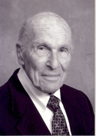
Harvey Picker
1915-2008
“Harvey Picker and his wife, Jean, believed that the American healthcare system was technologically and scientifically outstanding, but that it was not adequately sensitive to the concerns and comforts of patients”
“Understanding and respecting patients’ values, preferences and expressed needs are the foundation of patient-centered care”*
*picekerinsstitute.org

Slide 3

“Through the Patient’s Eyes”
1993
Picker/Commonwealth Program for Patient-Centered Care Established in 1987
Focus groups with patients and family members to “explore patients’ needs and concerns as patients themselves define them”

Slide 4
Dimensions of Patient-Centered Care
1. Respect for patients’ values, preferences and expressed needs
2. Coordination and integration of care
3. Information, communication and education
4. Physical comfort
5. Emotional support and alleviation of fear and anxiety
6. Involvement of family and friends
7. Transition and continuity
8. Access to Care

Slide 5

“Crossing The Quality Chasm:
A New Health System for the 21st Century”
Institute of Medicine, 2001
“Between the health care we have and the care we could have lies not just a gap, but a chasm
The committee is confident that Americans can have a health care system of the quality they need, want and deserve.”

Slide 6
“Crossing The Quality Chasm:
A New Health System for the 21st Century”
Institute of Medicine, 2001
“But we are also confident that this higher level of quality cannot be achieved by further stressing current systems of care.
The current care systems cannot do the job.
Trying harder will not work.
Changing systems of care will.”

Slide 7
6 Dimensions of Quality
Health Care should be
Safe
Effective
Patient-Centered
Timely
Efficient
Equitable

Slide 8
Safe
“avoiding injuries to patients from the care that is intended to help them”

Slide 9
Effective
“providing services based on scientific knowledge to all who could benefit and refraining from providing services to those not likely to benefit (avoiding underuse and over use respectively)”

Slide 10
Patient-Centered
“providing care that is respectful of and responsive to individual patient preferences, needs, and values and ensuring that patient values guide all clinical decisions”

Slide 11
Timely
“reducing waits and sometimes harmful delays for both those who receive and those who give care”

Slide 12
Efficient
“avoiding waste, including waste of equipment, supplies, ideas, and energy”

Slide 13
Equitable
“providing care that does not vary in quality because of personal characteristics such as gender, ethnicity, geographic location and socio-economic status”

Slide 14
6 Dimensions of Quality
Health Care should be
Safe
Effective
Patient-Centered
Timely
Efficient
Equitable

Slide 15
Command Philosophy
“All Hands” message to all of the 1800 military staff at Naval Pensacola and out 12 branch clinics in 4 states on my first day as Commanding Officer (CEO)
“The Institute of Medicine report “Crossing the Quality chasm: A New Health System for the 21st Century” recommended six goals for the health services of the 21st century health system; that its health services be safe, effective, patient-centered, timely, efficient, and equitable.
All of our efforts, as a system and as individuals, should always be guided by our unswerving commitment to those six goals”

Slide 16
Command Philosophy
“All Hands” message to all of the 1800 military staff at Naval Pensacola and out 12 branch clinics in 4 states on my first day as Commanding Officer (CEO)
“The purpose of outlining my command philosophy for the Naval Hospital and its Branch Clinics is to provide a common framework for carrying out our mission.
My philosophy can be grouped under the following three statements”

Slide 17
Command Philosophy
“All Hands” message to all of the 1800 military staff at Naval Pensacola and out 12 branch clinics in 4 states on my first day as Commanding Officer (CEO)
“If you’re not having fun, you are not doing it right”
“The main thing,
Is to keep the main thing,
The main thing”
“I go where the puck is going to be,
not where it is”

Slide 18
Command Philosophy
“All Hands” message to all of the 1800 military staff at Naval Pensacola and out 12 branch clinics in 4 states on my first day as Commanding Officer (CEO)
“Our teaching role, as home to one of Navy Medicine’s Family Practice Residency Training Programs, is central to our mission.
In that same spirit, I would like to promote an environment where can all be teachers and learners – part of a learning organization.”

Slide 19
Excerpts from Nomination Package for
2003 Picker Institutional Award submitted by
Jona Raasch COO National Research Corporation
“Naval Hospital Pensacola
Is the top U.S. performer for the Continuity and Transition dimension of Care
Has moved from scores that fell average in 2000 to scores that significantly out performed the Military Health System (MHS) in all seven of the Picker Dimensions measured

Slide 20
Excerpts from Nomination Package for
2003 Picker Institutional Award submitted by
Jona Raasch COO National Research Corporation
“Naval Hospital Pensacola (NHP)
Has achieved a 73.2% overall “would definitely recommend rating compared to a Military Health System (MHS) average of 59.6%
61.1 % of NHP’s patient population rate their overall satisfaction as “Excellent” compared to the 45.5% that their MHS comparison group achieves
Has achieved a significantly higher level of performance compared to their MHS comparison group in their patient’s overall experience of care

Slide 21
Excerpts from Nomination Package for
2003 Picker Institutional Award submitted by
Jona Raasch COO National Research Corporation
“Naval Hospital Pensacola (NHP) realizes the importance that leadership and culture play in the creation of a patient-centered culture.
As part of this understanding, NHP has taken the six aims of the Institute of Medicine, as outlined in the “Crossing the Quality Chasm” and made them the foundation of their strategic plan

Slide 22
Command Philosophy
“All Hands” message to all of the 1800 military staff at Naval Pensacola and out 12 branch clinics in 4 states on my first day as Commanding Officer (CEO)
“Our teaching role, as home to one of Navy Medicine’s Family Practice Residency Training Programs, is central to our mission.
In that same spirit, I would like to promote an environment where can all be teachers and learners – part of a learning organization.”

Slide 23
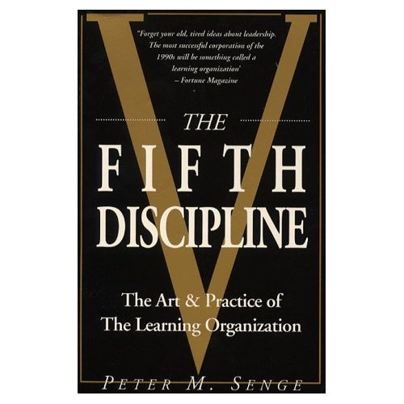
The Fifth Discipline
The Art & Practice of Learning Organizations
Peter M. Senge 1990
“Forget your old, tired ideas about leadership.
The most successful corporation of the 1990s will something called a learning organization”
-Fortune Magazine

Slide 24

Best Care at Lower Cost
The Path to Continuously Learning Health Care in America
Institute of Medicine 2012
“Health care in America presents a fundamental paradox.
The past 50 years have seen an explosion in biomedical knowledge, dramatic innovation in therapies and surgical procedures, and managements of conditions that previously were fatal, with ever more exciting clinical capabilities on the horizon
Yet American health care is falling short on basic dimensions of quality outcomes, costs and equity”

Slide 25
The Vision
“The committee believes that achieving a learning health care system … is both necessary and possible for the nation”

Slide 26
“Uneven Diffusion of Knowledge”
“Best Care at Lower Cost: The Path to Continuously Learning Health Care in America”
Institute of Medicine September 2012
While the supply of knowledge is increasing, there are lags in the time it takes to translate evidence into clinical practice.
It is estimated that the results of a landmark study will take 15-16 years to be widely implemented following the study’s publication.

Slide 27
The Fifth Discipline
The Art & Practice of Learning Organizations
Peter M. Senge 1990
“Forget your old, tired ideas about leadership.
The most successful corporation of the 1990s will something called a learning organization”
-Fortune Magazine

Slide 28

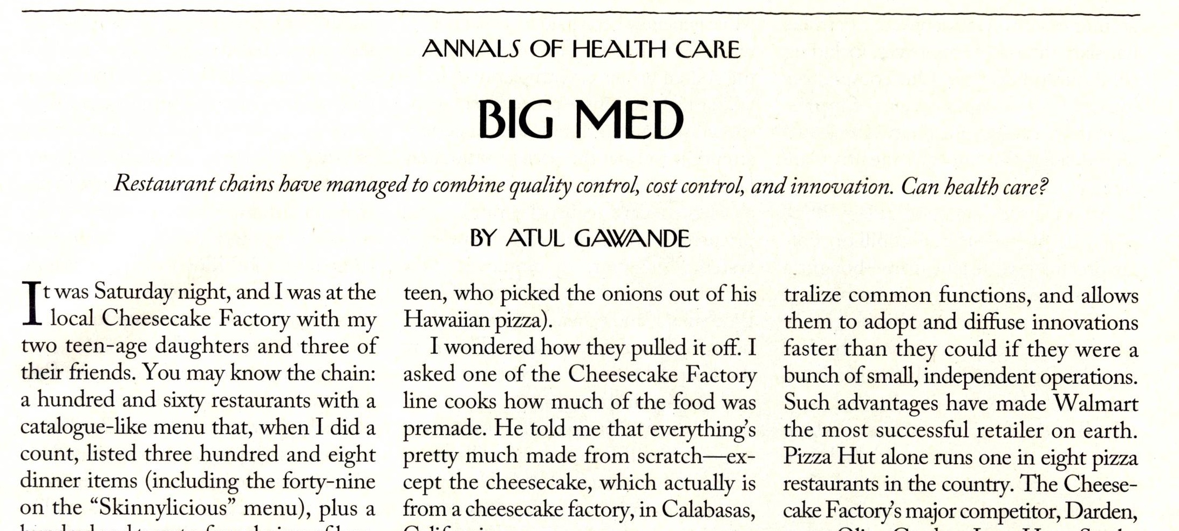
BIG MED
Atul Gawande
The New Yorker, August 13 & 20, 2012
“Medicine has long resisted the productivity revolutions that transformed other industries. But the new chains aim to change this”
Restaurant chains have managed to combine quality control, cost control, and innovation. Can health care?

Slide 29
Characteristics of a
Continuously Learning Health Care System
Science and Informatics
Patient-Clinician Partnerships
Incentives
Culture

Slide 30
Characteristics of a
Continuously Learning Health Care System
Science and Informatics
Real-Time Access to Knowledge
Digital Capture of the Care Experience

Slide 31
Characteristics of a
Continuously Learning Health Care System
Patient-Clinician Partnerships
Engaged, Empowered Patients

Slide 32
Characteristics of a
Continuously Learning Health Care System
Incentives
Incentives Aligned for Value
Full Transparency

Slide 33
Characteristics of a
Continuously Learning Health Care System
Culture
Leadership-Instilled Culture of Learning
Supportive System Competencies

Slide 34
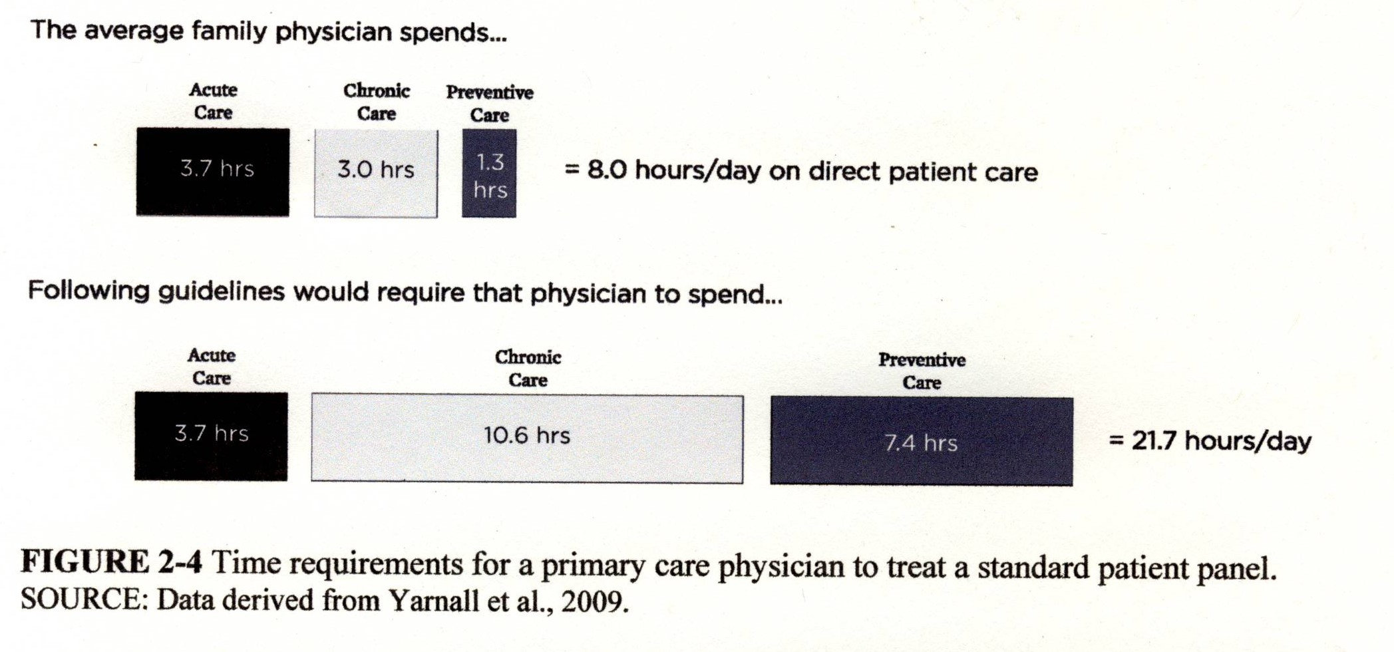
Patient-Centered Care:
‘Sounds nice, but I’m already too busy as it is now’ figure reproduced from Best Care at Lower Cost, IOM 2012

Slide 35
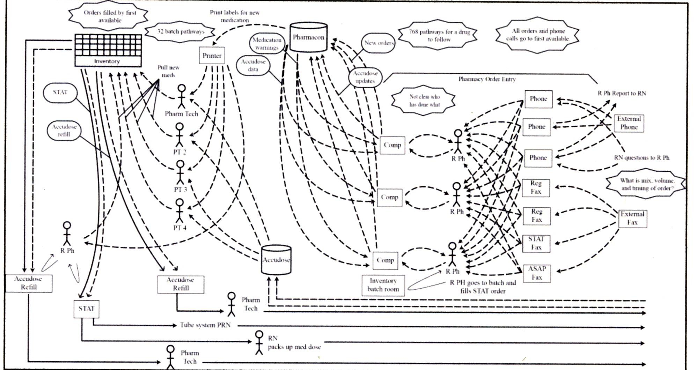
Diagram of process for filling a medication order at one academic medical center
Adapted and reprinted with permission from Thompson et al, 2003 in IOM Best Care at Lower Cost Report Sept 2012

Slide 36
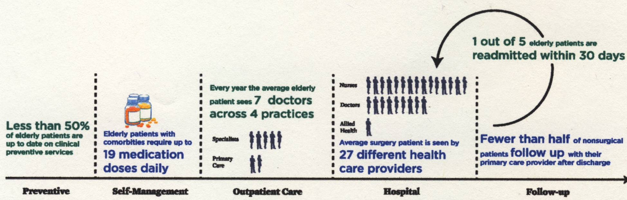
Representative timeline of a patient’s experience in the U.S. Health care system
Best Care at Lower Cost, IOM 2012 data derived from Boyd et al, 2005; Jencks et al, 2009; Pham et al, 2007; Shenson et al, 2007; Whitt et al 2007

Slide 37
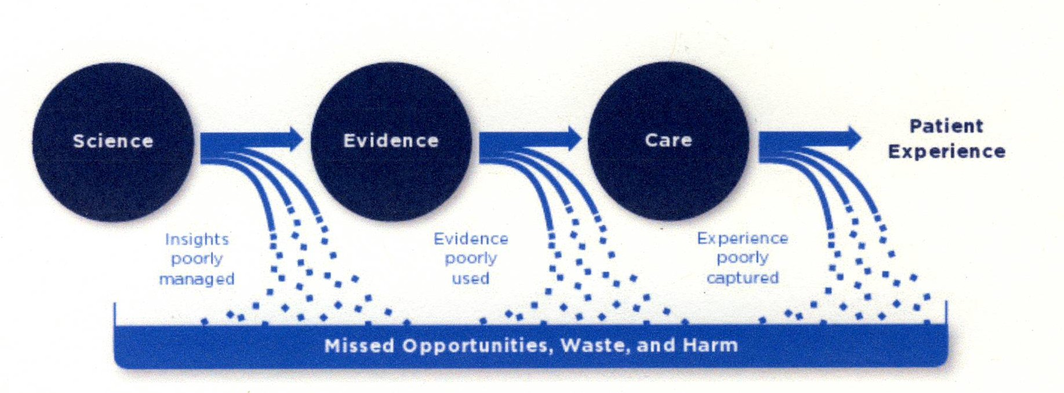
Schematic of the
Health Care System Today
Best Care at Lower Cost, IOM 2012

Slide 38
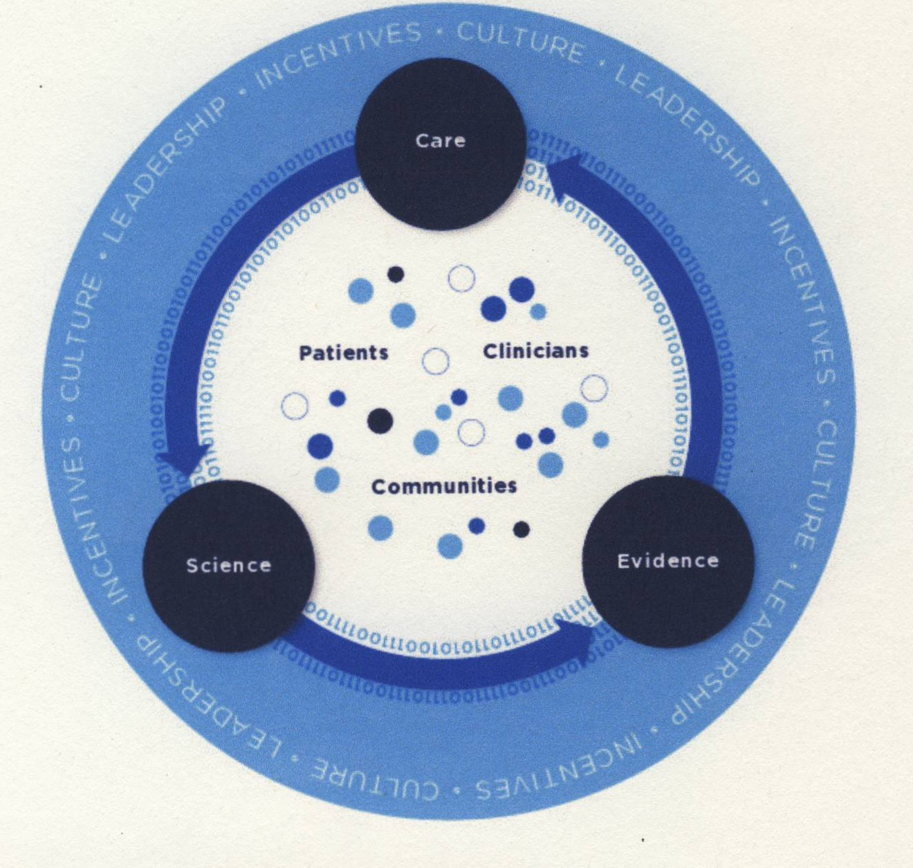
Schematic of
Learning Health Care system
Best Care at Lower Cost, IOM 2012

Slide 39

Escape Fire www.escapefiremovie.com
WHAT IS AN ESCAPE FIRE?
es•cape ﬁre: noun, \is-’kap\fīuhr\
A swath of grassland or forest intentionally ignited in order to provide shelter from an oncoming blaze.
2. An improvised, effective solution to a crisis that cannot be solved using traditional approaches.

Slide 40
“My idea of a team is that I’m the boss and I give all the orders…
Comment by a physician
at a focus group on leadership that I conducted

Slide 41
…..I know it’s wrong, and I know it doesn’t even work, but I don’t know what else to do”

Slide 42
Working together as a team is a learnable skill
however…
Training for physicians has not historically included training in this skill

Slide 43

“The most important measure of how good a game I played was how much better I made my teammates play”
Bill Russell Boston Celtics as quoted in Fifth Discipline Workbook

Slide 44

The Blue Angels
The U.S. Navy’s Flight Demonstration Squadron

Slide 45
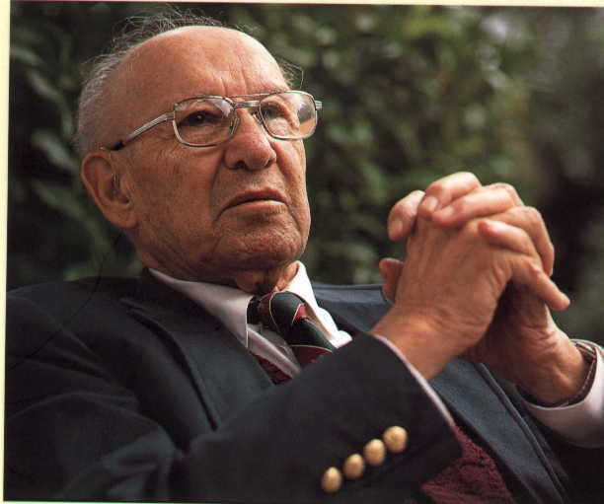
The goal of leadership is to create a team whose collective strengths makes individual weaknesses irrelevant”
------ Peter Drucker

Slide 46

Crew Resource Management Training
began in commercial aviation in 1981

Slide 47

Yes to the Mess:
Surprising Lessons from Jazz
Frank J Barrett
“Jazz bands actually are organizations designed for innovation, and the design elements from jazz can be applied to other organizations seeking to innovate”
Further, in order for jazz bands to be successful, they require a commitment to a mind-set, a culture, practices and structures, and a leadership framework that is strikingly similar to what it takes to foster innovation in organizations.”

Slide 48
Patient-Centered Care:
Lessons from Risk Communication on “Trust and Credibility”*
Determinants of “Trust and Credibility” in two different types of situations:
“Low Concern”
“High Concern”
*Covello www.centerforriskcommunication.org

Slide 49
Patient-Centered Care:
Lessons from Risk Communication on “Trust and Credibility”*
Determinants of “Trust and Credibility”
In “Low Concern” situations:
“competence / expertise” account for about 80%
“commitment / dedication”, “honesty / openness”, “caring /empathy” make up the rest
*Covello www.centerforriskcommunication.org

Slide 50
Patient-Centered Care:
Lessons from Risk Communication on “Trust and Credibility”*
Determinants of “Trust and Credibility”
In “High Concern” situations;
  Your “Competence / Expertise”
  account for only about 15-20%
“Caring / Empathy” account for about 50% and they are largely judged within the first 30 seconds
(commitment / dedication & honesty / openness each account for about 15-20%)
*Covello www.centerforriskcommuncation.org

Slide 51
Patient-Centered Care:
Lessons from Risk Communication*
Low Concern Situations:
“Just the facts ma’am,
nothing but the facts”
High Concern Situations:
“I don’t care how much you know
until I know how much you care”
* Covello www.centerforriskcommunication.com

Slide 52
Patient-Centered
“providing care that is respectful of and responsive to individual patient preferences, needs, and values and ensuring that patient values guide all clinical decisions”

Slide 53
Current Status of
Patient-Centered Care*
“Fewer than half of patients receive clear information on the benefits and trade-offs of the treatments for their condition and fewer than half are satisfied with their level of control in medical decision making”
Better Care at Lower Cost, IOM 2012

Slide 54
Benefits of Patient-Centered Care*
The use of patient-centered care in a primary care setting has been associated with reduced pain and discomfort, faster recovery in physical health, and improvements in emotional health
If implemented properly, meaningful engagement of patients in their own care has the potential to reduce costs. For example, it has been reported that informed patients are up to 20% less likely than other patients to choose elective surgery
*Better Care at Lower Cost, IOM 2012

Slide 55
Escape Fire www.escapefiremovie.com
WHAT IS AN ESCAPE FIRE?
es•cape ﬁre: noun, \is-’kap\fīuhr\
A swath of grassland or forest intentionally ignited in order to provide shelter from an oncoming blaze.
An improvised, effective solution to a crisis that cannot be solved using traditional approaches.

Slide 56
Dimensions of Patient-Centered Care
1. Respect for patients’ values, preferences and expressed needs
2. Coordination and integration of care
3. Information, communication and education
4. Physical comfort
5. Emotional support and alleviation of fear and anxiety
6. Involvement of family and friends
7. Transition and continuity
8. Access to Care

Slide 57
6 Dimensions of Quality
Health Care should be
Safe
Effective
Patient-Centered
Timely
Efficient
Equitable

Slide 58
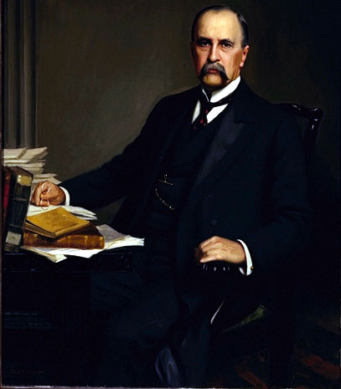
The Future is Today
Sir William Osler

Slide 59
QUESTIONS
AND/OR
COMMENTS?
RichSujBuck@Gmail.com

